Slide 1
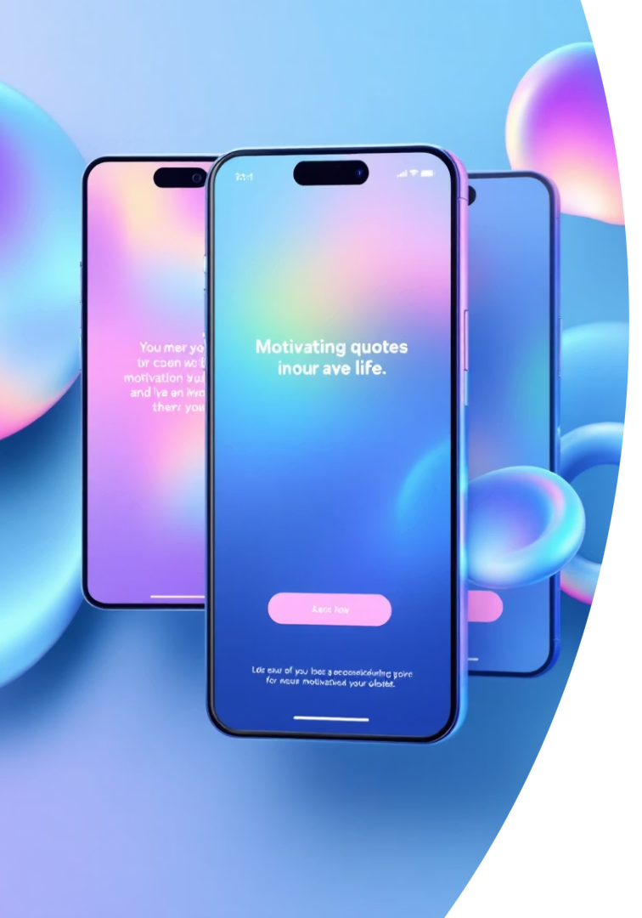

Motivate Me 🚀
Struggling to find motivation when it matters most? Motivate Me delivers AI-powered inspiration tailored to you.
by Ian Macharia

Slide 2

The Problem: Generic Motivation Doesn’t Work
Core Issue
1
Most motivational quotes are static and impersonal.
They don’t adapt to moods, struggles, or personal goals.
2
Pain Points
Traditional quote apps lack personalization and feel irrelevant.
Users waste time searching for meaningful inspiration.
3
4
Inspiration should be real-time and tailored like a conversation.

Slide 3
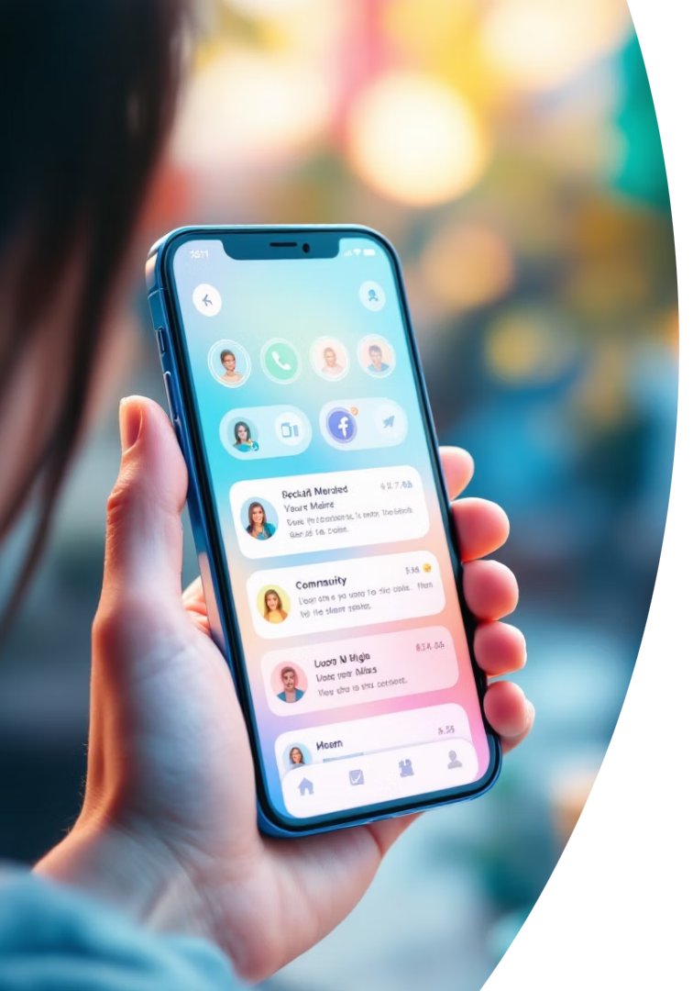
Solution
Context-Aware Quotes
Delivers motivational messages tailored to user moods and situations.
AI-Driven Matching
Combines RAG and semantic models to find relevant inspiration instantly.
Adaptive Experience
Uses TF-IDF, SVM, and conversation history for truly personalized motivation.
Real-Time Companion
Removes guesswork by understanding and responding to emotional needs.

Slide 4

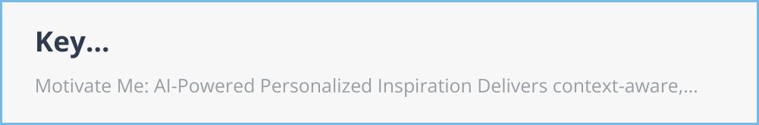
Technical Architecture

Slide 5
Key Features
Motivate Me: AI-Powered Personalized Inspiration
Delivers context-aware, adaptive inspirational quotes using machine learning and retrieval-augmented generation (RAG) to match user moods and situations.
Seamless, Scalable Experience
Clean, responsive chatbot interface optimized for web and mobile, with plans for daily notifications, community contributions, and an enterprise API.
Advanced, Modular Architecture
Efficient ML pipeline combining TF-IDF, SVM, and compressed models. Flexible Python-based design enables easy expansion and optimization.

Slide 6

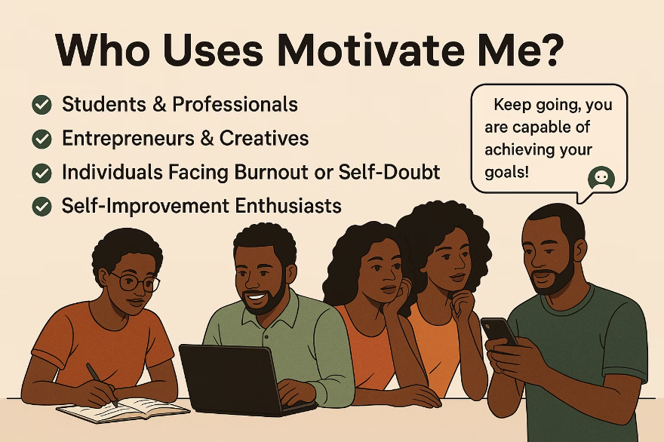
Who Uses Motivate Me?
Target Audience
Students & Professionals seeking daily inspiration for focus and growth
Entrepreneurs & Creatives needing motivation to face challenges innovatively
Individuals facing burnout or self-doubt craving real-time motivational support
Self-Improvement Enthusiasts focused on mindset shifts and goal setting
User Needs
Personalized inspiration aligned with unique journeys
Real-time AI support understanding moods and delivering relevant quotes
Simple, accessible tool for seamless daily motivation

Slide 7
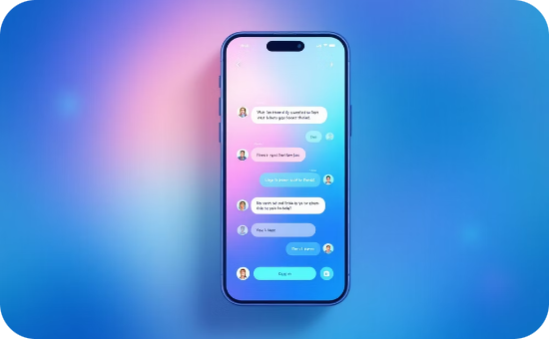


Pricing Model
Free Tier
Professional Tier - $9.99/month
Enterprise Tier
Access basic chatbot
Unlimited queries
Custom quotes and API access
Limited daily queries
Advanced RAG chatbot features
Team accounts with admin controls
Ad-supported experience
Export quotes, ad-free
Priority support and training

Slide 8
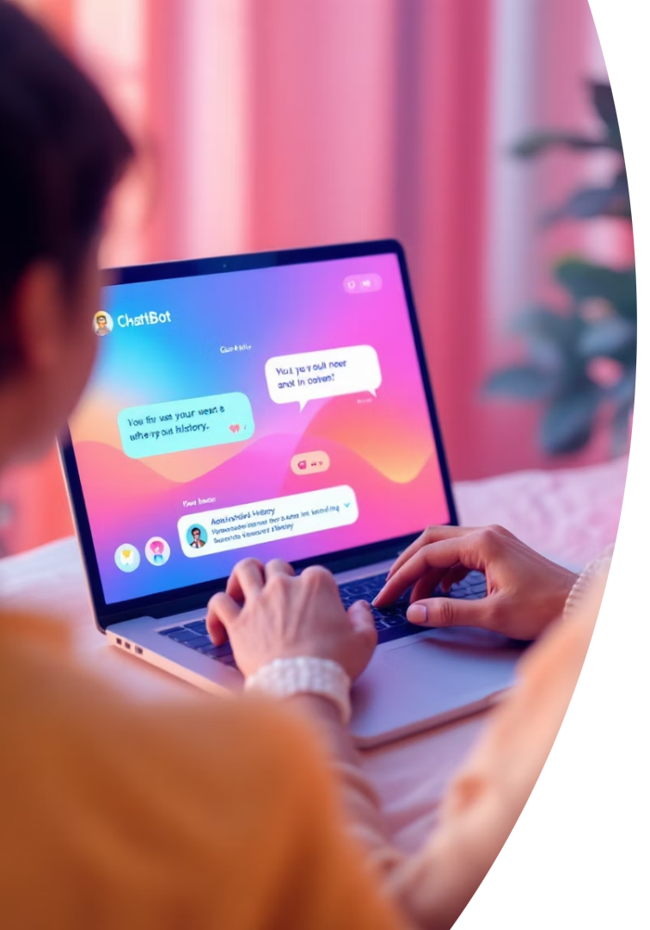
Demo: Basic Chatbot Flow
User Input
Describe situation or mood
Processing
System interprets input
Quote Matching
Finds relevant motivational quote
Response
Returns quote with author and chat history

Slide 9

Implementation Challenges
Model Optimization
Reduce size for fast, web-friendly deployment
Quote Relevance
Ensure quotes accurately match user input
Feature Balance
Maintain simplicity without losing functionality
Responsive Design
Consistent user experience on all devices

